Slide 1
DOCUMENT COLLECTION VISUALIZATION

Slide 2
DOCUMENT COLLECTION VISUALIZATIONS
In most cases of document collection visualizations, the goal is to place similar documents close to each other and dissimilar ones far apart.
We compute the similarity between all pairs of documents and determine a layout.
The common approaches are graph spring layouts, multidimensional scaling, clustering (k-means, hierarchical, EM, support vector), and self organizing maps.
We present several document collection visualizations, such as self organizing maps, cluster maps, and themescapes

Slide 3
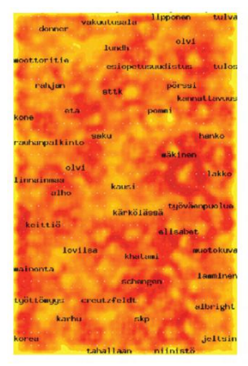
SELF ORGANIZING MAPS
A self-organizing map is an unsupervised learning algorithm using a collection of typically 2D nodes, where documents will be located.
Each node has an associated vector of the same dimensionality as the input vectors (the document vectors) used to train the map.
We initialize the SOM nodes, typically with random weights. We choose a random vector from the input vectors and calculate its distance from each node.
A self-organizing map (SOM) layout of Finnish news bulletins. The labels show the topical areas, and color represents the number of documents, with light areas containing more

Slide 4
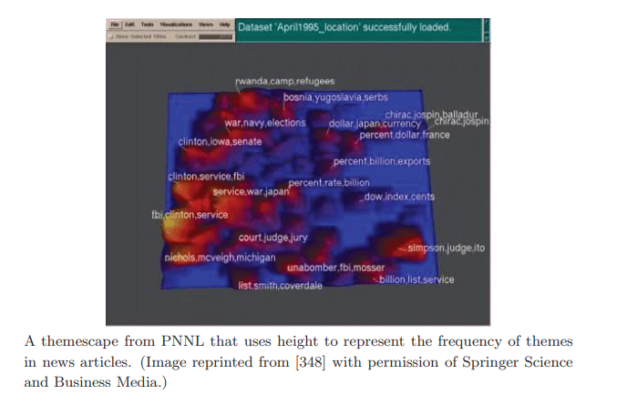
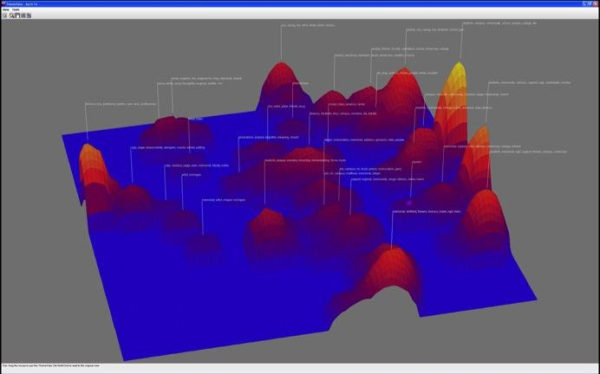
Themescapes
Themescapes are summaries of corpora using abstract 3D landscapes in which height and color are used to represent density of similar documents.
The example shown from Pacific Northwest National Labs represents news articles visualized as a themescape.
The taller mountains represent frequent themes in the document corpus (height is proportional to number of documents relating to the theme).

Slide 5
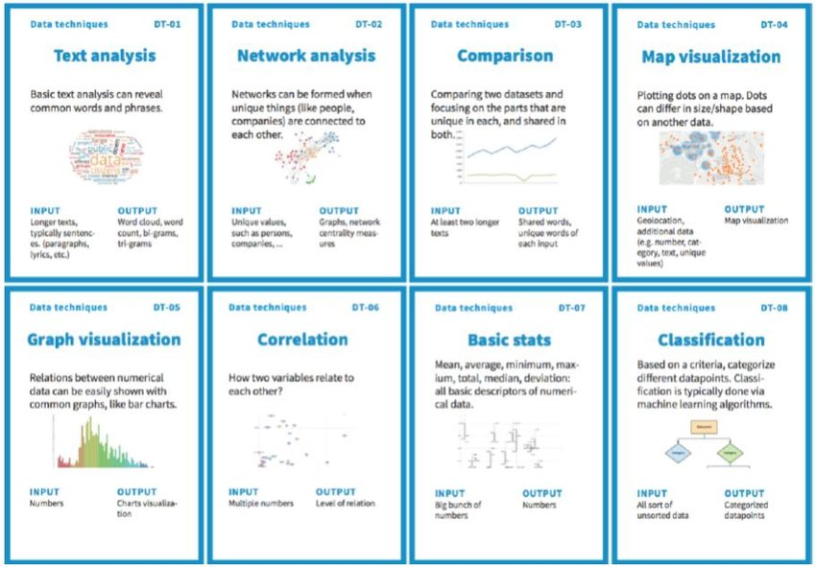
DOCUMENT CARDS
Document cards are a compact visualization that represents the document’s key semantics as a mixture of images and important key terms, similar to cards in a top trumps game.
The key terms are extracted using an advanced text mining approach based on an automatic extraction of document structure.
The images and their captions are extracted using a graphical heuristic, and the captions are used for a semi semantic image weighting.

Slide 6
INTERACTION CONCEPTS
Interaction within the data and information visualization context is a mechanism for modifying what the users see and how they see it. Many classes of interaction techniques exist, including:
• Navigation—user controls for altering the position of the camera and
for scaling the view (what gets mapped to the screen) such as panning,
rotating, and zooming.
• Selection—user controls for identifying an object, a collection of objects, or regions of interest to be the subject of some operation, such
as highlighting, deleting, and modifying.
• Filtering—user controls for reducing the size of the data being mapped
to the screen, either by eliminating records, dimensions, or both.

Slide 7
• Filtering—user controls for reducing the size of the data being mapped
to the screen, either by eliminating records, dimensions, or both.
• Reconfiguring—user controls for changing the way data is mapped to
graphical entities or attributes, such as reordering the data or layouts,
thereby providing a different way of viewing a data subset.
• Encoding—user controls for changing the graphical attributes, such as
point size or line color, to potentially reveal different features.
• Connecting—user controls for linking different views or objects to show
related items.
• Abstracting/elaborating—user controls for modifying the level of detail.

Slide 8
INTERACTION OPERATORS
SELECTION OPERATOR
FILTERING OPERATOR
RECONFIGURING OPERATOR
ENCODING OPERATOR
CONNECTION OPERATOR
ABSTRACTION OPERATOR

Slide 9
NAVIGATION OPERATORS
Navigation (also sometimes referred to as exploration) is used to search for a subset of data to be viewed, the orientation of this view, and the level of detail (LOD).
Navigation operators can work in absolute or relative coordinates within their particular spaces.
The user can control the step size between views, with the trade-off being smoothness versus the number of projections that need to be inspect

Slide 10
SELECTION OPERATOR
In selection, the user isolates a subset of the display components, which will then be subjected to some other operation, such as highlighting, deleting, masking, or moving to the center of focus.
Many variations on selection have been developed to date [395], and decisions need to be made on what the results should be for a sequence of selections.
Selection can be articulated in many different ways. The user may click on entities, paint over a selection of entities (e.g., holding the mouse button down while moving over the entities of interest), or otherwise isolate the entities via techniques such as bounding boxes and lassoes.

Slide 11
FILTERING OPERATORS
Filtering, as the name implies, reduces the volume of data to be visualized by setting constraints specifying the data to be preserved or removed.
The distinction between filtering and selection followed by deletion or masking is a subtle, but important point.
Filtering, in general, is most often done in an indirect manner, e.g., the filter specification is not performed on the data visualization itself, but via a separate interface or dialog box. In fact, filtering is often done prior to viewing the data, to avoid overloading the data display.
Selection is most often done in a direct manner, by indicating objects on the visualization via mouse motions, for example. The operation performed on the selected subset can result in a view that is indistinguishable from a filtering operation.

Slide 12
RECONFIGURING OPERATORS
Reconfiguring the data within a particular visualization can often be used to expose features or cope with complexity or scale.
By reorganizing the data, say by filtering some dimensions and reordering those that remain, different views are provided to the user.

Slide 13
ENCODING OPERATORS
Any given data set can be used to generate countless different visualizations.
Recoding can provide the user a library of possible different types of visualization; features of the data that are difficult or impossible to see with one such mapping might become quite apparent in another.
Other forms of encoding operations include those that modify the color map used, the size of graphical entities, and their shape. These can be considered variations within a particular type of visualization, and can be used to emphasize or reveal features of interest.

Slide 14
CONNECTION OPERATORS
A frequent use for selection operations is to link the selected data in one view to the corresponding data in other views.
While other forms of connection between sub windows of an application exist, such as when opening a new data file, linked selection is probably the most common form of communication between windows found in modern visualization tools.

Slide 15
ABSTRACTION/ELABORATION OPERATORS
In dense data and information displays, it is often desirable to focus in on a subset of the data to acquire details (elaboration) while reducing the level of detail (abstraction) on other parts of the data set.
One of the most popular techniques of this type is using distortion operators.
While some researchers classify distortion as a visualization technique, it is actually a transformation that can be applied to any type of visualization. Like panning and zooming, distortion is useful for interactive exploration

